Slide 1

HOW TO USE RA
Kingsley Jin

Slide 2

Agenda
What is RA
What can u get
How to get

Slide 3

WHAT IS RA
RA, which called Retail Analytics, offers a rich business intelligence solution to retail industry users
RA是一个给零售行业使用者提供有价值的商务智能解决方案的零售分析系统
Retail Analytics has several integrated data sources, including Oracle Retail Merchandising System (RMS) and Oracle Retail Price Management System (RPM)
RA有几个集成的数据源，包括RMS和RPM

Slide 4

WHAT CAN U GET
Aggregate data
聚合数据
Graphs for the data
数据图表
Mails from system
来自系统的邮件

Slide 5
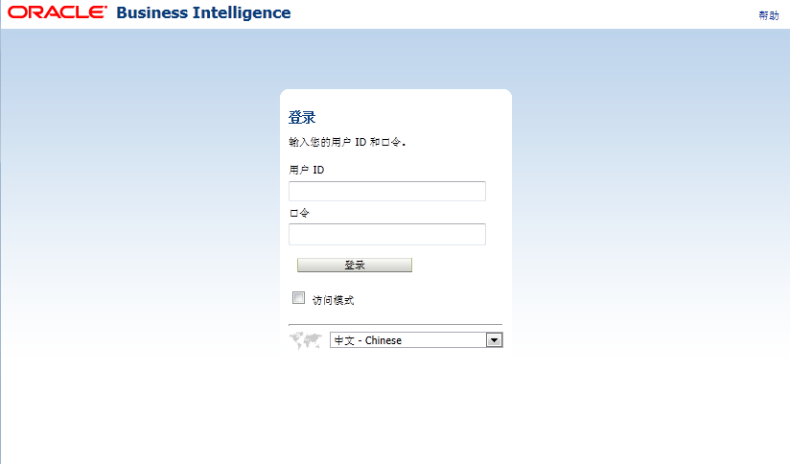

HOW TO GET
Log in http://raap1.bbg.com.cn:9705/analytics/
RA_TEST / RA_TEST123

Slide 6
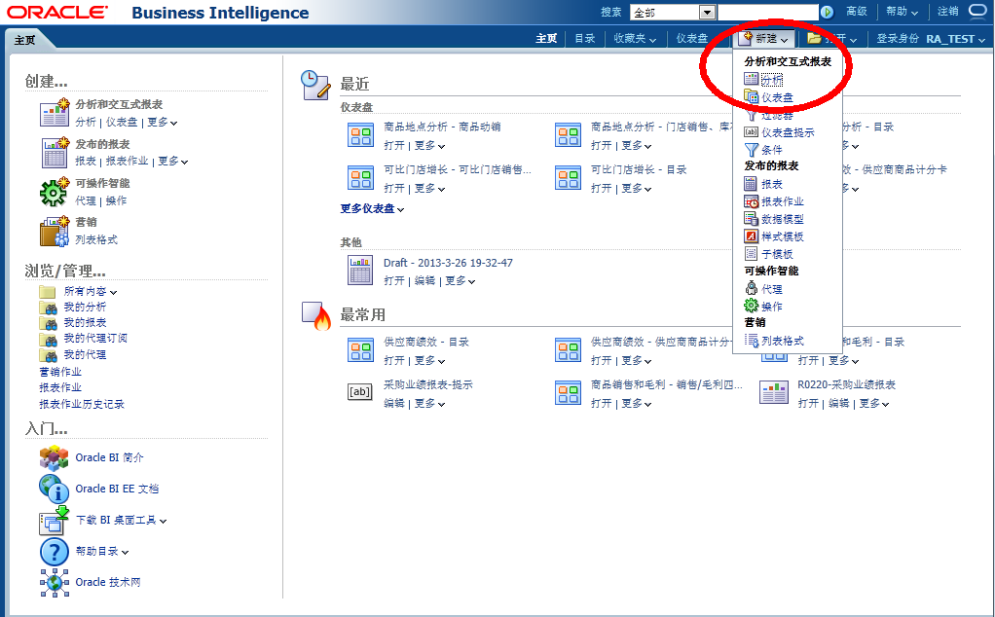

HOW TO GET

Slide 7
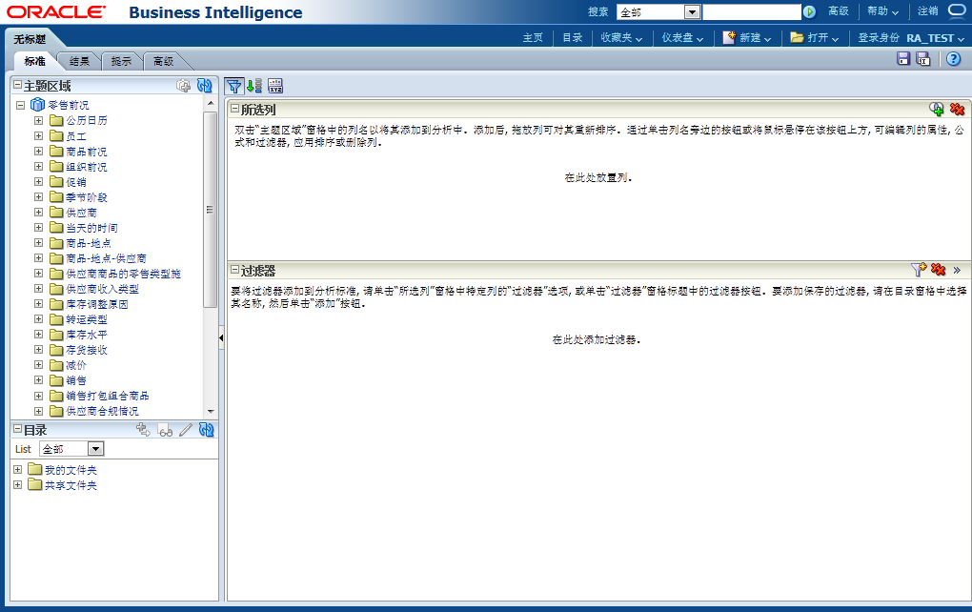
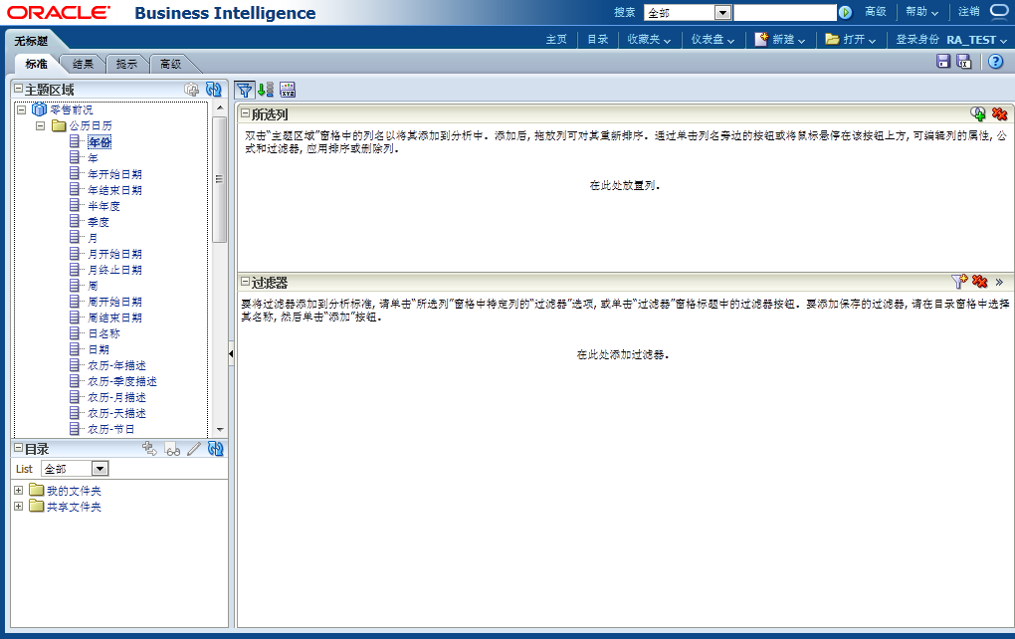
HOW TO GET
维
度
和
指
标

Slide 8
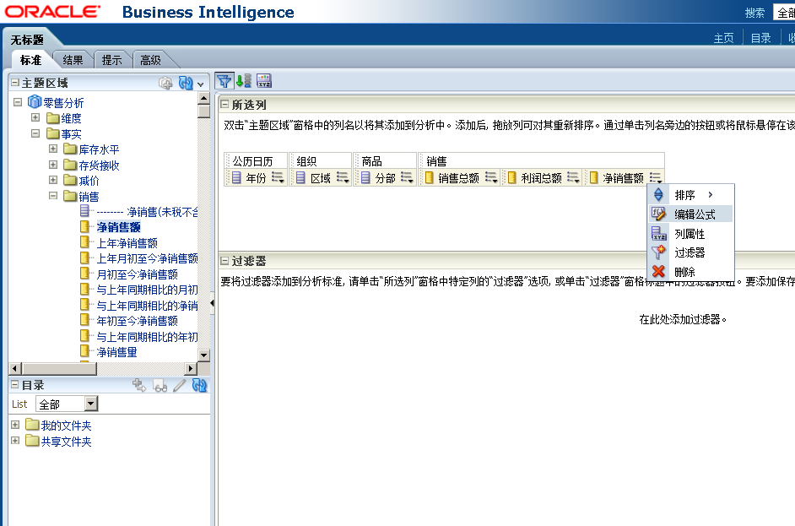
HOW TO GET

Slide 9
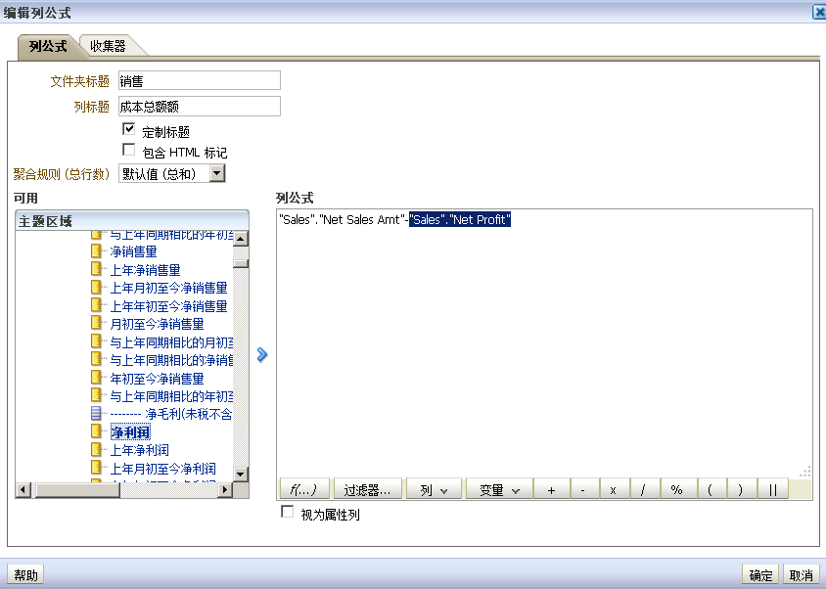
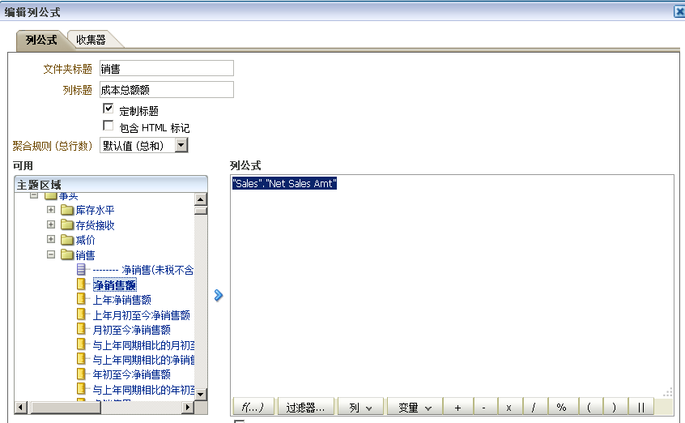
HOW TO GET
Change the name of button
Get formula
Choose the option of formula
Choose the option of formula

Slide 10
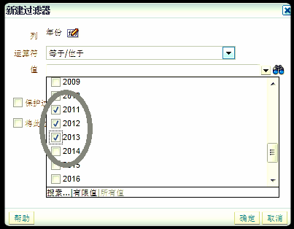
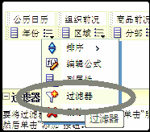
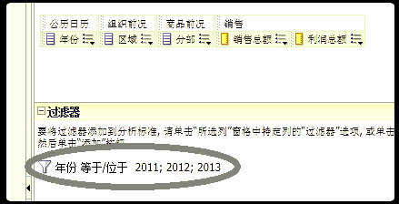
HOW TO GET

Slide 11
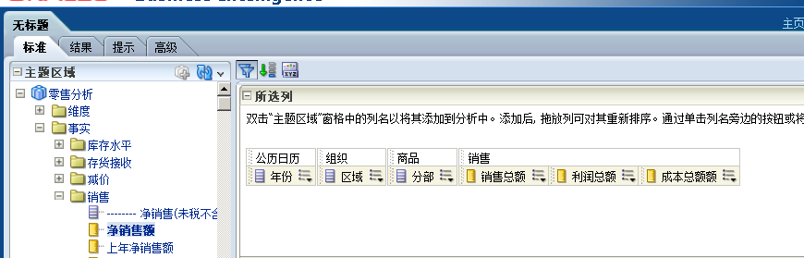
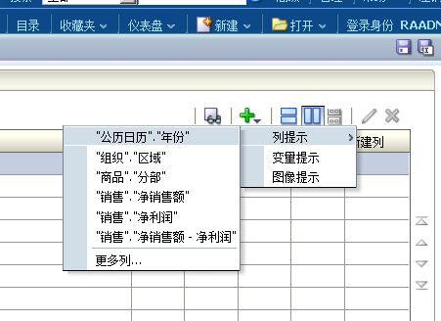
HOW TO GET

Slide 12
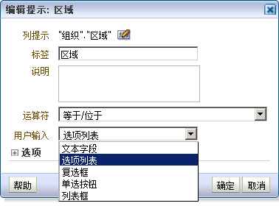
HOW TO GET

Slide 13
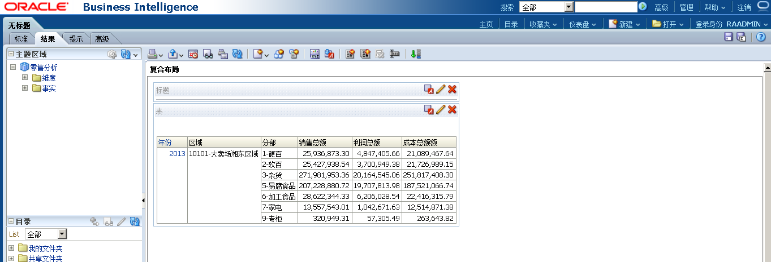
HOW TO GET

Slide 14

Thank you

